Slide 1


2022
ANALYTICAL RESEARCH:
THE RUSSIAN AUTO INDUSTRY – 2022

Slide 2


STATISTICS ON THE WORLD CAR MARKET 2021
In 2021, the global car market grew by 4.6%: the number of new cars increased to 81.31 mln. Such an increase occurred primarily due to low starting indicators in the first and second quarters: in the same period of 2020, many car dealerships were closed due to the pandemic, so sales were low. Therefore, in the first six months of 2021, double-digit growth in passenger car sales occurred in all major markets:
Despite this percentage growth in the first half of the year, it was not possible to reach the indicators of the pre-Covid period (in 2019, the market for new cars was 90.3 mln). In particular, the shortage of semiconductors does not allow the market to fully recover. At the same time, the deficit arose even before the coronavirus pandemic, but later the situation became more complicated.
This was affected not only by high demand for semiconductors from household appliance manufacturers, but also by supply problems due to adverse weather conditions and emergencies: a fire in the spring of 2021 at the Renesas Electronics microchip factory led to a reduction in global automotive production. If automakers lost 1.4 mln cars in the first quarter, they lost 2.6 mln cars in the second quarter. According to AEB, the fourth quarter also turned out to be a failure: a shortage of semiconductors, an increase in car prices and a decrease in financial stocks among potential buyers led to a decrease in sales. Sales volumes in the world from October to December 2021 decreased by 18-20%.
China increased its indicators
by 27% (9.83 mln)
USA – by 29% (8.294 mln)
Europe – by 27% (6.486 mln)
Japan – by 12%
Brazil – by 32%
Russia – by 37%
India – by 93% (1.495 mln)
in total
up to 3.914 mln
+7 (495) 740-16-01
contact@delprof.ru

Slide 3
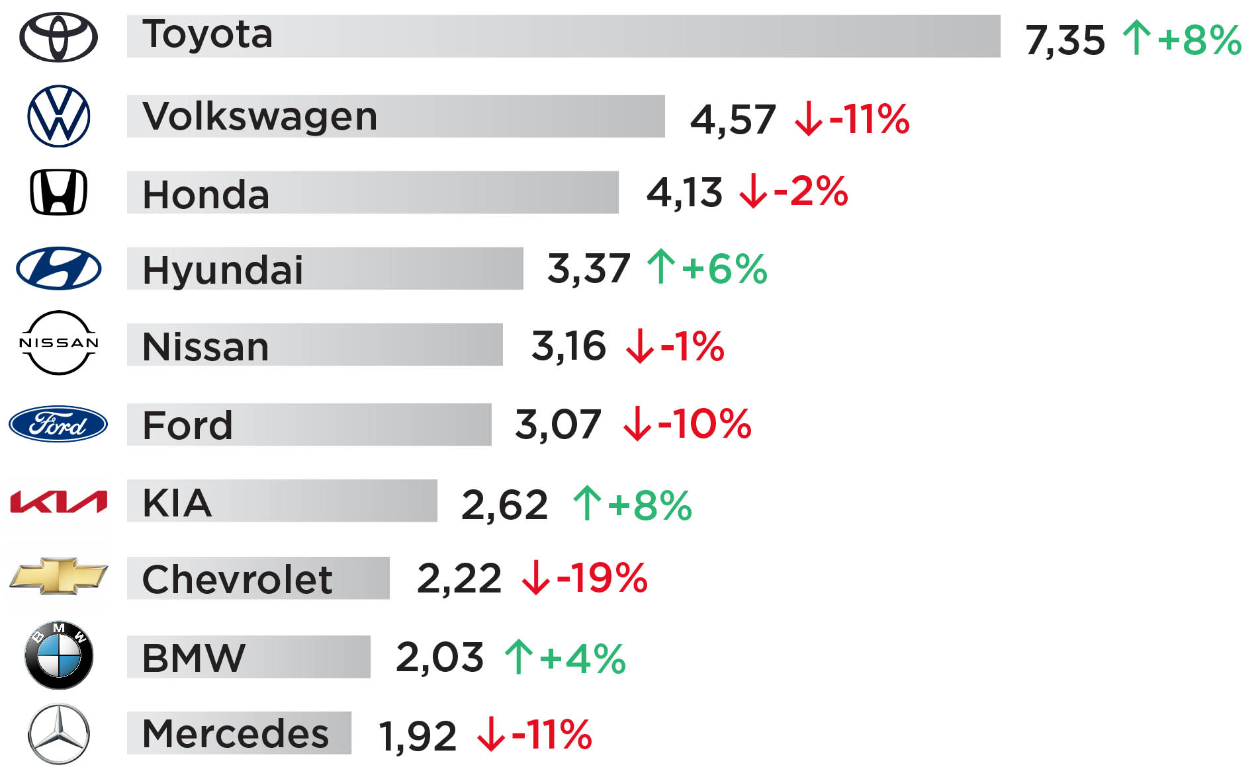
Fig. 1. The world ranking of the most popular cars in 2021
Volkswagen AG is in the second place both in production and sales, despite the fact that the concern faced a shortage of semiconductors and delivered 4.5% (up to 8.9 mln cars). At the same time, the lag behind Toyota for 2021 has only increased. Volkswagen sold 4.57 mln of 8.9 mln cars produced: almost half (2.11 mln) in the Chinese market. Brands Nissan and Ford showed a drop in global sales by 1% and 10%, respectively, while Hyundai moved up two positions, increasing the number of sales by 6%.
In the premium car segment, BMW has been able to regain its leadership for the first time since 2016, selling 2.03 mln cars. This is the only premium brand that has increased the number of sales (by 4%). The other brands only lost in demand: Mercedes lost ground by 11% (1.92 mln), Audi - by 2% and Lexus - by 16%. China topped the top five markets for premium vehicles with sales of 2.79 million. It is followed by the US (1.89 mln), Germany (0.72 mln), the UK (0.43 mln) and South Korea (0.34 mln).
Toyota Corolla (985 ths.) became the best-selling car in the world. For the first time, the TOP-10 of the world's bestsellers included electric vehicles - Tesla Model 3 and Chinese Wuling Mini EV. Demand for battery-powered vehicles doubled in 2021, with 6.6 mln vehicles sold worldwide, half of them (3.4 mln) in China. The share of electric vehicles in the market was 8.6%.
Source: JATO Dynamics
Toyota remains the most popular brand and the largest automaker in the world according to the JATO Dynamics Agency. Over the past year, Toyota has produced 10.5 mln. cars, including Lexus, Daihatsu and Hino brands, which is 10% more than in 2020. The company has sold 7.35 mln. passenger cars worldwide. Most of all, cars of this corporation are in demand in the markets of the USA (2.03 mln.), China (1.64 mln.) and Japan (1.22 mln.).
+7 (495) 740-16-01
contact@delprof.ru

Slide 4
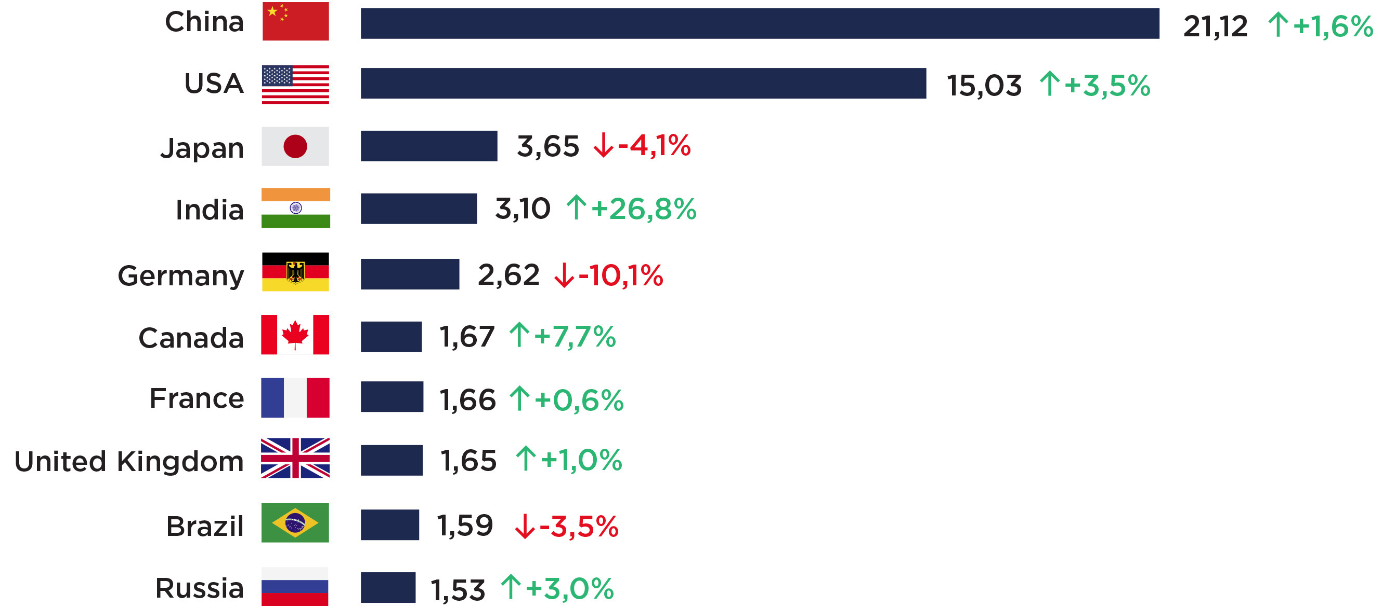
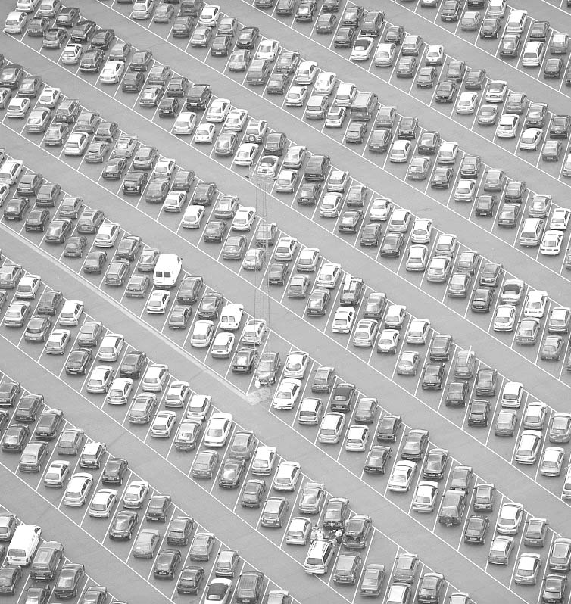
Fig. 2. World ranking of the largest automotive markets in 2021 (mln cars)
Source: JATO Dynamics
In terms of sales, China was in the first place: 21.12 mln cars were sold there during the year. Demand has even increased in the Chinese market for the first time in the last four years. The USA and Japan consistently occupy the second and third places. But India managed to almost completely restore its market in a year, which collapsed heavily due to covid restrictions in 2020. Despite the fact that Canada does not have its own automobile industry of passenger cars (only numerous factories of international brands), the country managed to rise from the ninth place to the sixth. Russia goes last in the top ten largest car markets in the world.
+7 (495) 740-16-01
contact@delprof.ru

Slide 5
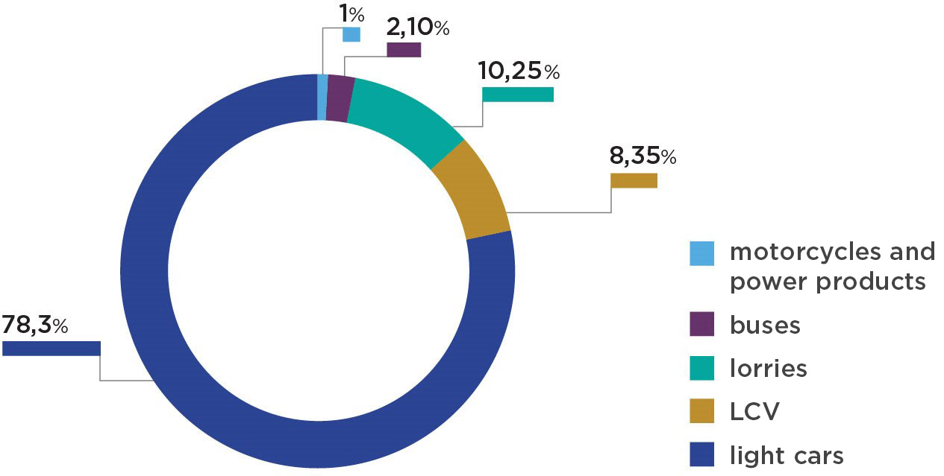
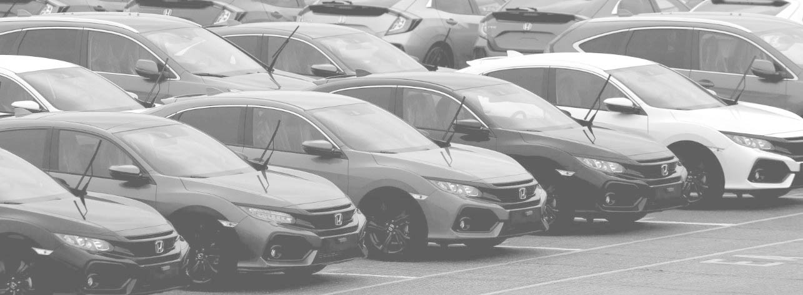
Key indicators of the Russian market in 2021
Fig. 3. Structure of the car and motorcycle market by segment in 2019
The production of vehicles in 2021 increased by 10% and rose beyond 1.5 mln. cars. According to Electronic Passport JSC and Autostat, in 2021 Russia produced:
1.352 mln passenger cars, which is 7.3% more than a year earlier;
144 ths. light commercial vehicles, which is 38% more than a last year;
177.7 ths. trucks of all classes (including chassis and dump trucks) – an increase of 26.1%;
36,7 ths. buses of all classes, including minibuses (+6.5%);
18,4 ths. motorcycles (+12.6%).
Source: Electronic Passport JSC and Autostat

Slide 6
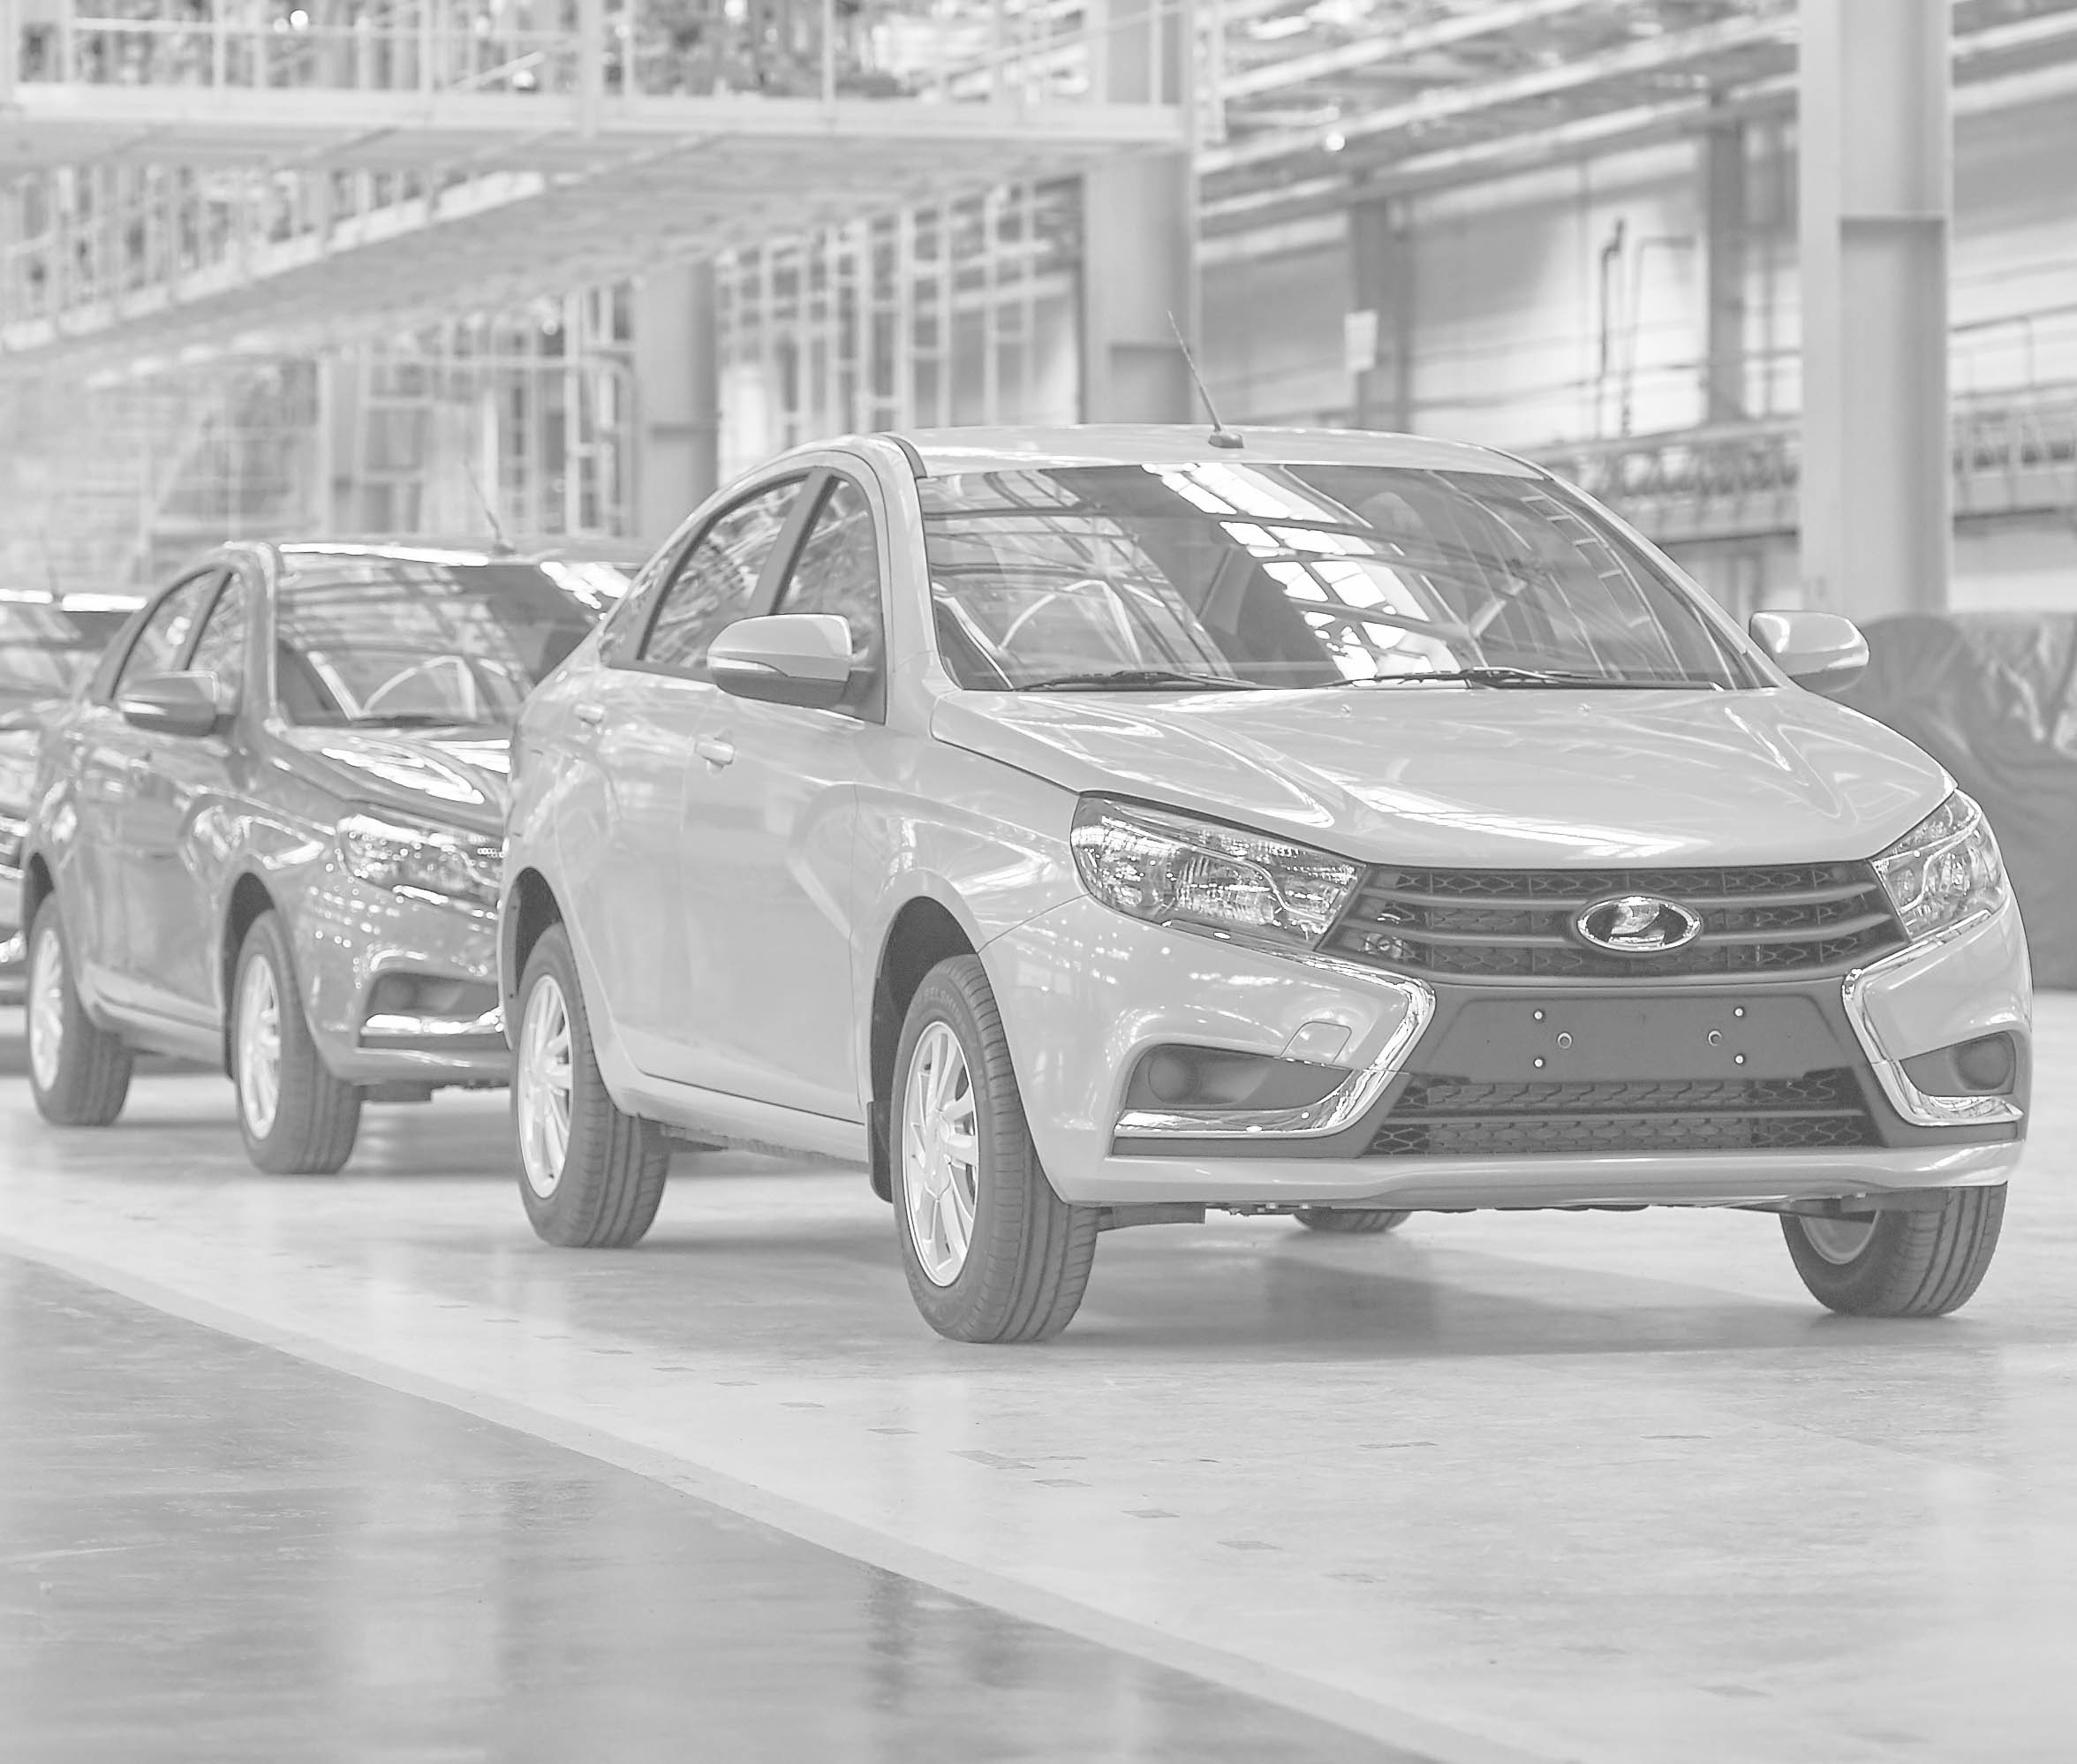
According to the Association of European Businesses (AEB), 1.667 mln new passenger cars and light commercial vehicles were sold in the Russian market. Thus, the market grew by 4.3% compared to 2020. In the first half of the year, the growth was 37% (871 ths.) due to low starting indicators, and already in the second half of the year there was a drop: in October sales decreased by 18%, and in November and December — by 20%. 796 ths. cars were sold from July to December.
At the same time, experts say that the Russian market has great potential. And sales growth in 2021 could be even higher: due to the shortage of cars, it was not possible to satisfy all consumers' demand. The shortage is attributed to a shortage of electronic components, logistics disruption and rising prices for raw materials, in particular steel.
Despite the fact that in 2021 the deferred demand has decreased, the interest of buyers in the most popular models remains high.
+7 (495) 740-16-01
contact@delprof.ru

Slide 7
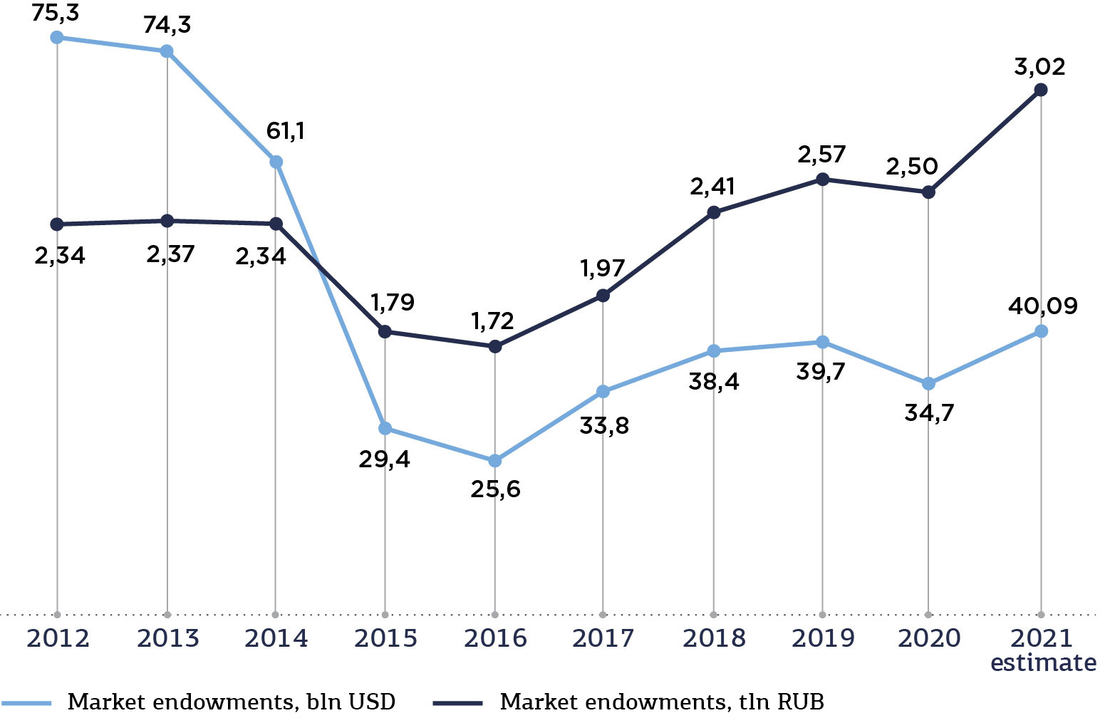
Fig. 4. The capacity of the Russian car market in monetary terms 2021
over
3,02 tln RUB*
Russians spent on new passenger cars
* the record figure for the Russian market
Compared with the indicators of 2020, the market capacity in rubles increased by 21%, and in dollar terms – by 18%. Despite the record figure in rubles, in the US currency (USD 40.9 bln.), it is far from the record values of 2012: that year, 75 billion dollars were spent on passenger cars.
Obviously, the reason for this is the ruble exchange rate, which has been falling in recent years: the Russian currency has lost half its value over 9 years. In this regard, the capacity of the car market is growing in rubles, which is clearly visible since 2017. In 2020, growth slowed down due to the pandemic, and last year there was a rise in car prices due to a global shortage of semiconductors, which also affected the market capacity.
Source: Autostat
+7 (495) 740-16-01
contact@delprof.ru

Slide 8
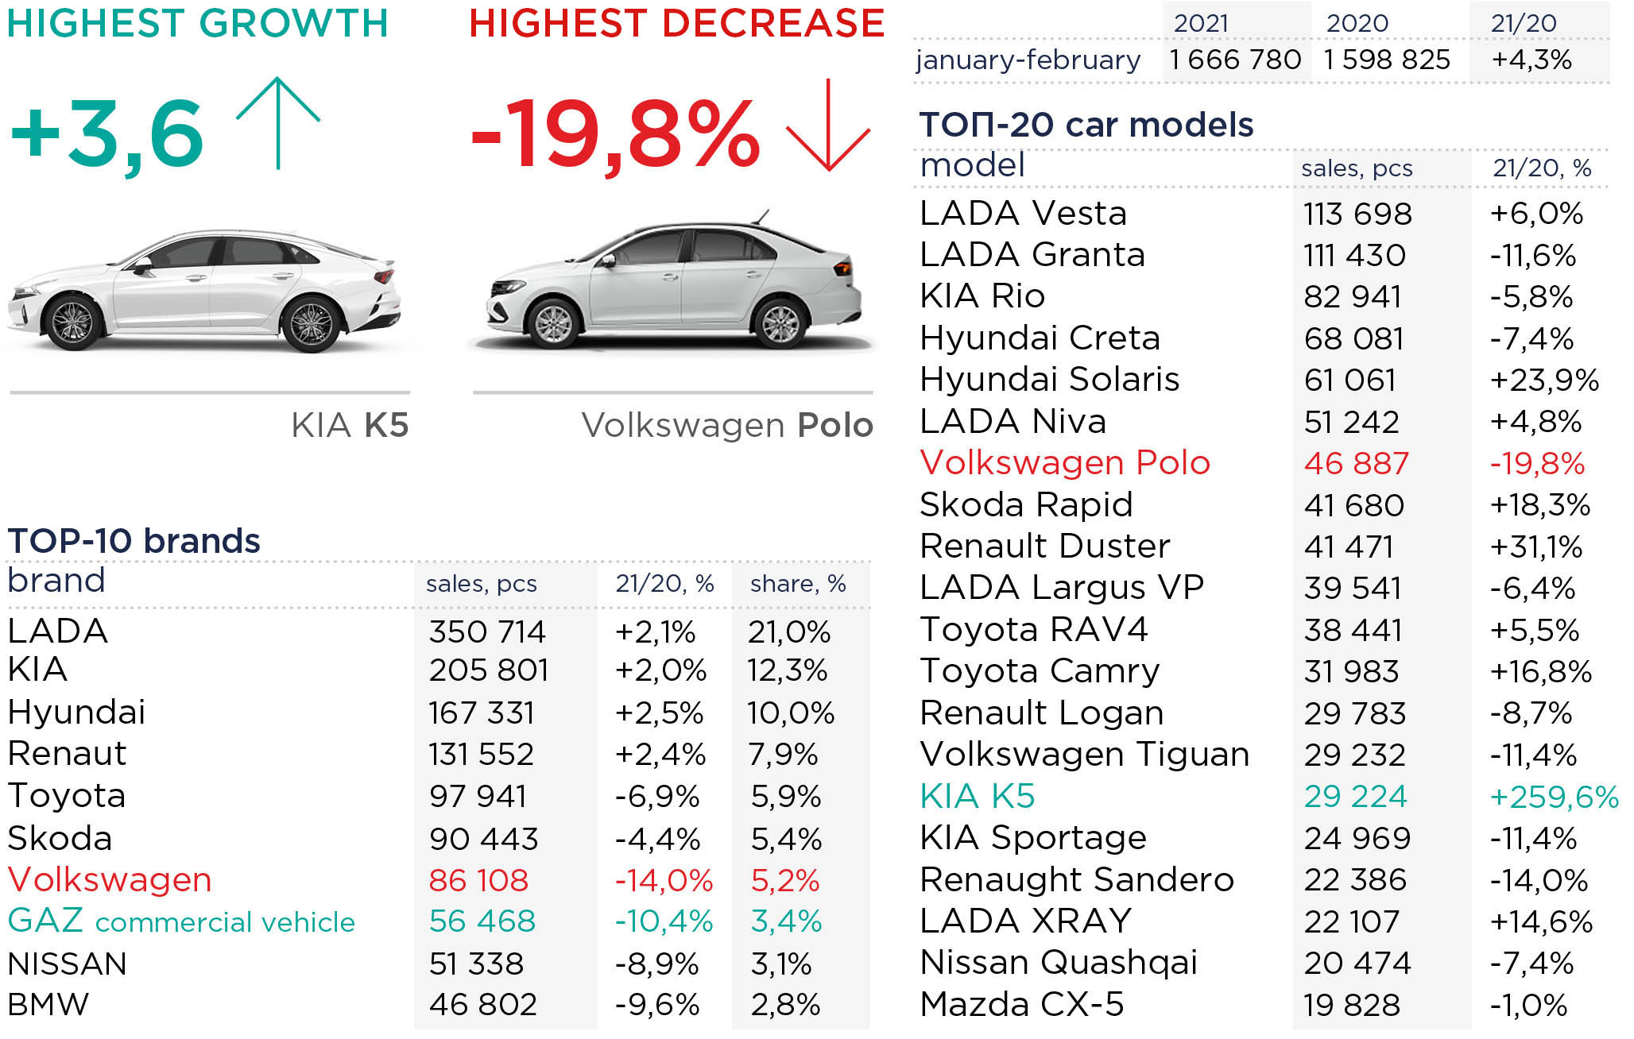
The most popular car brands in Russia
Fig. 5. Leaders in sales in the Russian car market 2021
Source: Autostat
+7 (495) 740-16-01
contact@delprof.ru

Slide 9
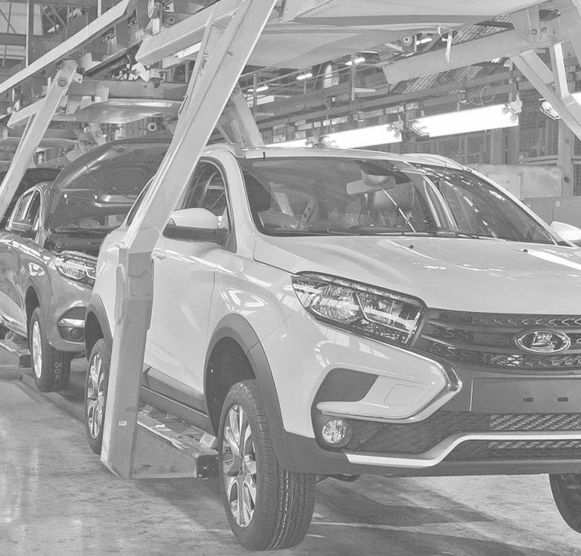
The domestic Lada brand remains the leader in sales in 2021, whose share in the Russian market is slightly more than 1/5 – 21%, which is 2.1% more than last year. Korean brands Kia (205,801) and Hyundai (167,331) also remain in demand among Russians, which showed growth in 2021 by 2% and 2.5%, respectively. From the list of TOP 10 brands, only three brands fell in sales: Skoda lost 4.4%, Volkswagen - 14% and Nissan – 8.9%. And the greatest growth was demonstrated by the GAZ brand, which produces commercial vehicles – +10.4%.
The rating of the most popular models is also headed by Lada: Lada Granta showed a drop of 11.6% due to a shortage of auto components, thus losing the lead to another model of the brand - Vesta. During the year, 113,698 Vesta and 111,430 Lada Granta cars were sold.
The most popular foreign car was Kia Rio (82,941), despite a decline in sales in the Russian market (by 5.8%). But another model of the Kia K5 brand showed a high sales growth (by 259.6%). More than threefold increase became possible due to the novelty of the model: Kia K5 appeared in the Russian market only in September 2020.
+7 (495) 740-16-01
contact@delprof.ru

Slide 10
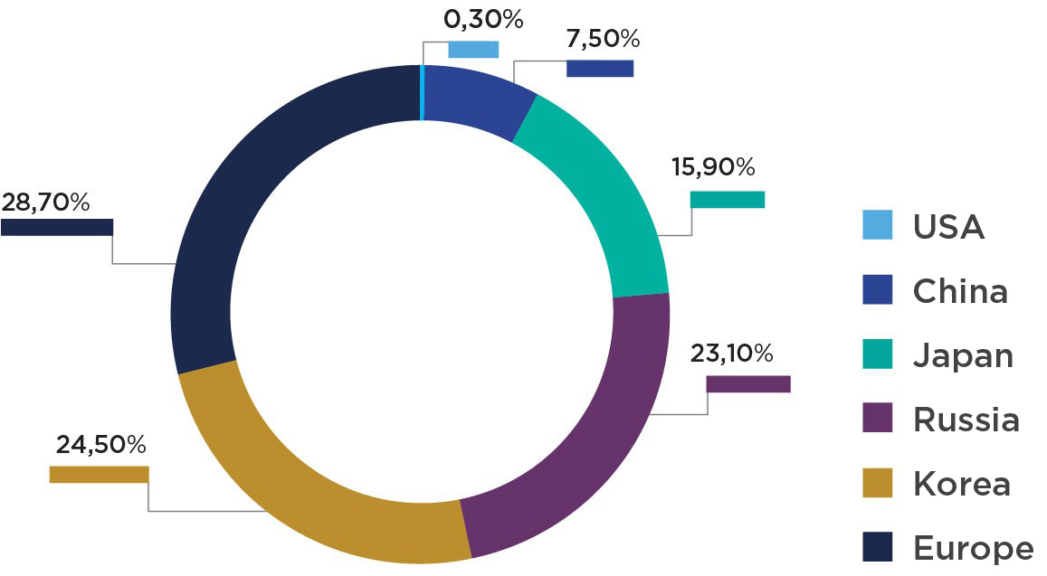
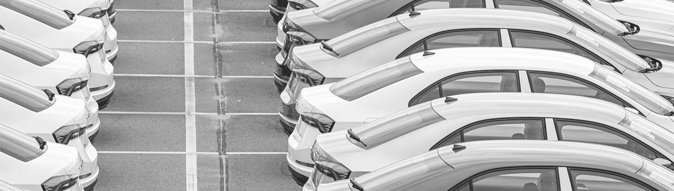
Fig. 6. The share of brands from different countries in the Russian market
Sales of Volkswagen Polo fell by almost 20% (to 46.8 ths. cars). At the same time, the model remains the most popular European car in Russia: every tenth passenger car sold by a European brand is a Volkswagen Polo. In total, European brands occupy 28.7% of the Russian market, that is, the largest share. Next Korean brands come with a market share of 24.5%, followed by domestically produced cars (23.1%), a third of which are Lada Vesta cars. American brands are in the least demand (0.3%): the best-selling car here was the Cadillac XT5 (18.5% of US brands). In 2021, the share of Chinese cars doubled to 7.5%. The share in the Chery Tiggo 7 Pro crossover segment was 12.2% of all new Chinese cars sold.
Chinese companies skillfully took advantage of the situation with a shortage of semiconductors in the world: unlike Europe, America, Japan, China did not have such an acute problem with microchips, since they had an alternative (own) production of the necessary components. In 2021, the Haval brand increased demand more than twice, Chery — three times, and Geely — by 59%. Chinese brands have already reached the level of Mitsubishi and Mazda sales volume.
Sales of new cars have increased in both the mass and premium segments. The share of the mass segment was 89.8%, the premium segment – 10.2%.
Source: Autostat
+7 (495) 740-16-01
contact@delprof.ru

Slide 11
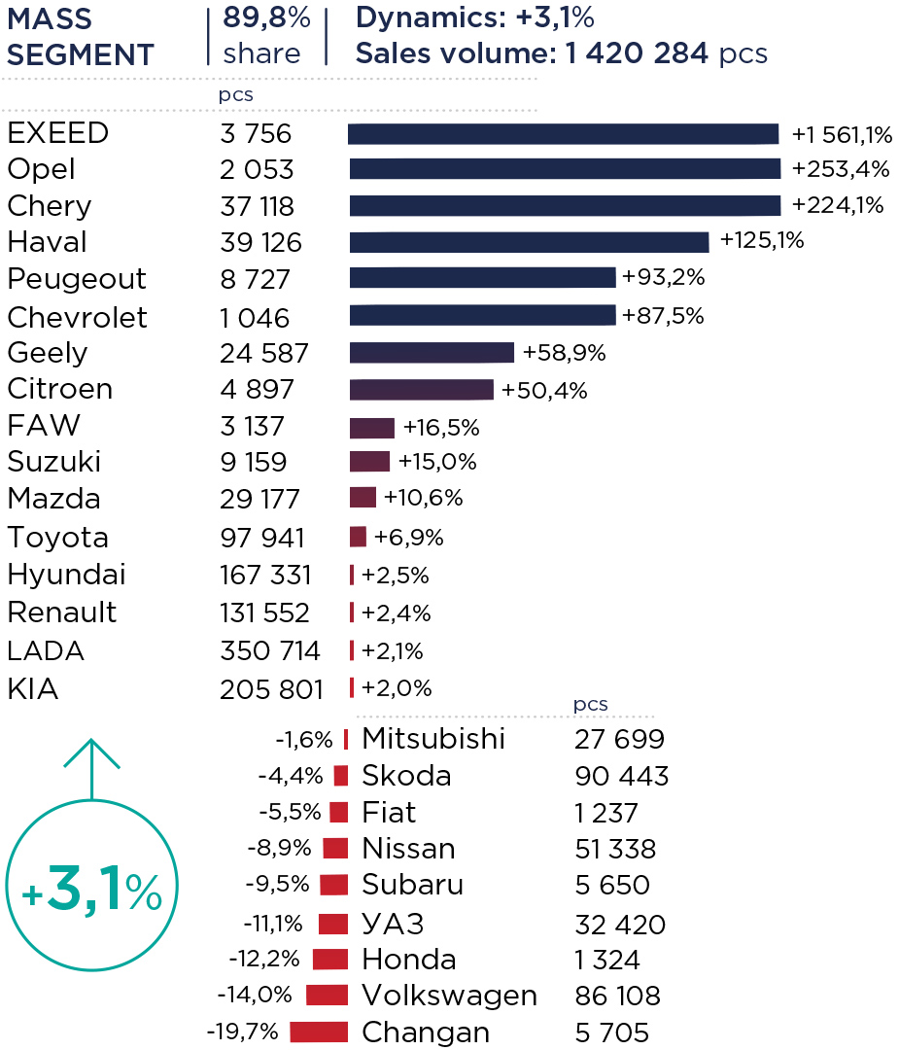
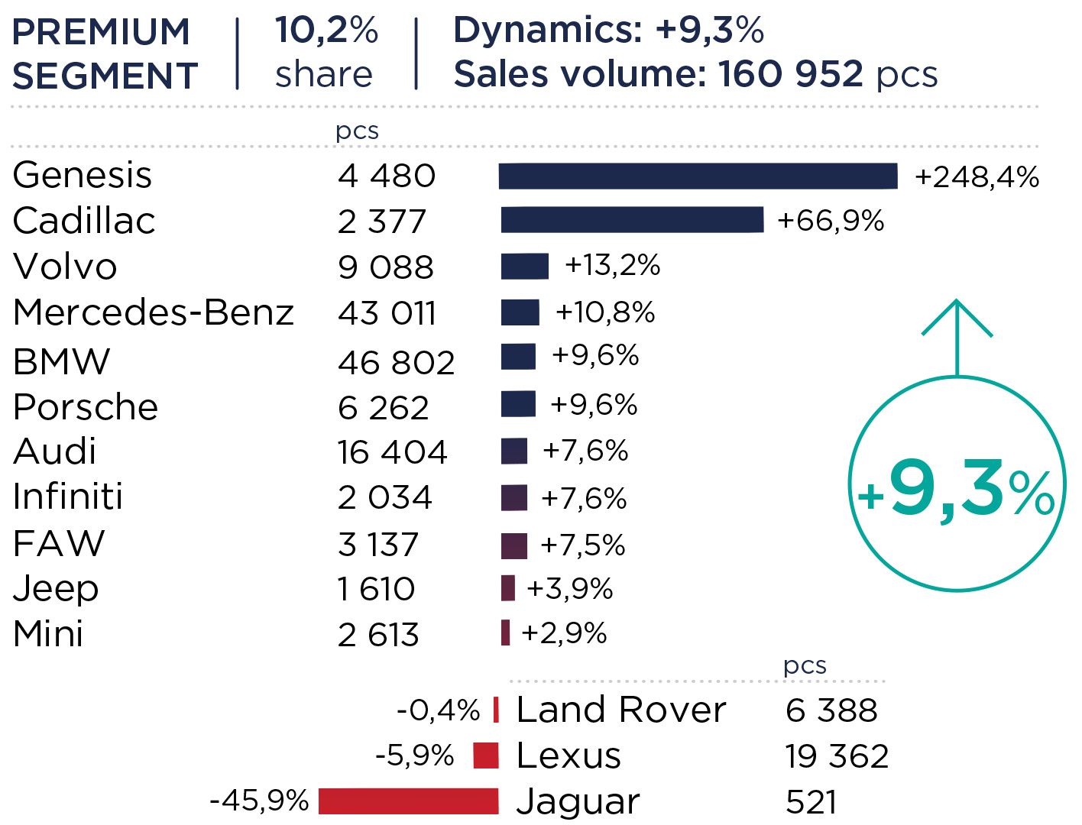
Fig. 7. Dynamics of the car market in Russia in 2021. Mass segment
Fig. 8. Dynamics of the car market in Russia in 2021. Premium segment
Source: Autostat
Source: Autostat

Slide 12
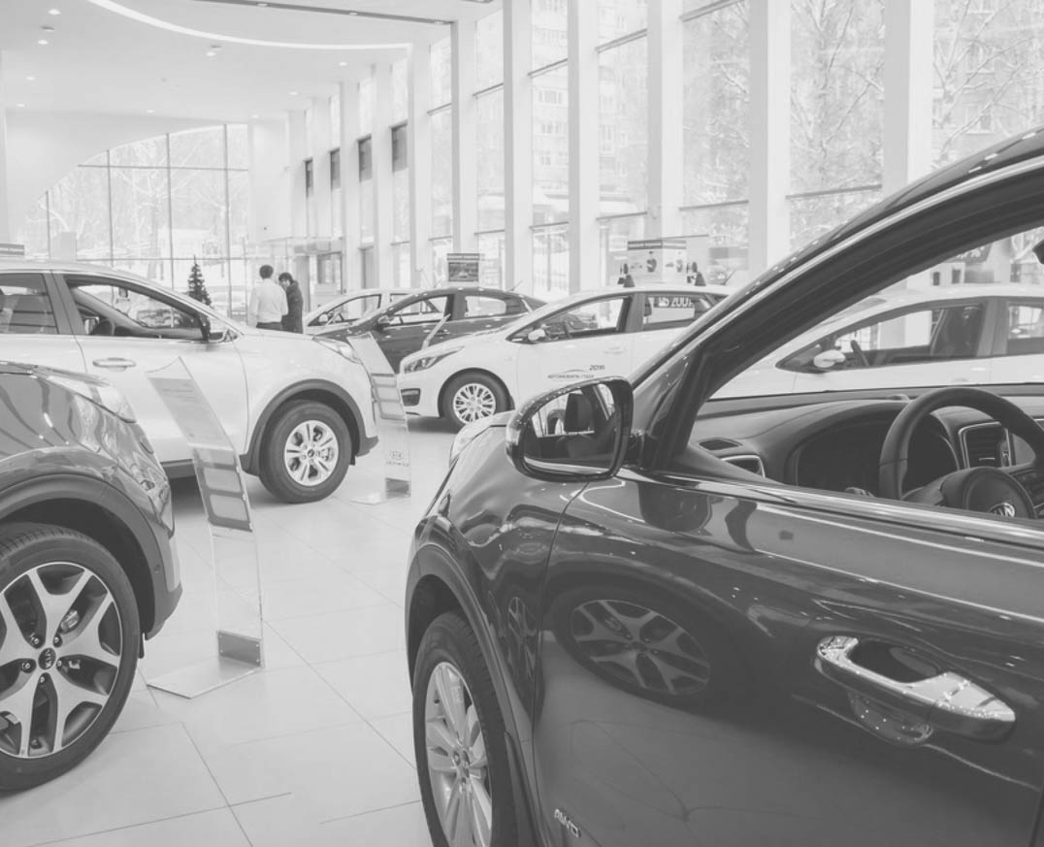
In the mass segment the growth was 3.1% to 1.42 mln. cars sold. According to AEB statistics, 16 brands that are in the top 25 in terms of sales in Russia have positive dynamics.
The Chinese brand EXEED (formerly CHERYEXEED) showed the greatest growth: its sales ran up by 1561.9% due to the low base of 2020 - less than 4 ths. cars of this brand were sold over the past year. Sales of Opel (Germany) and Chery (China) brands have more than tripled. Haval, Peugeot, Chevrolet, Geely, Citroen showed the growth of over 50%. Changan (-19.7%), VW (-14%) and Honda (-12.2%) have the largest drop in sales. The sales volume of the domestic UAZ also decreased by 11.1%.
In the premium car segment, sales rose by 9.3%. During the year, 161 ths. cars were sold. Compared to the mass segment, there is a smaller number of brands that have lost in demand (only three out of 13). These are Jaguar, which has almost halved sales (-45.9%) to 521 cars sold, Lexus (-5.9%) and Land Rover (-0.4%). Sales of the Genesis (248.4%) and Cadilac (67%) brands have increased significantly, although, let us remind you that Cadillac still occupies a very small share of the Russian market. BMW was the leader in the number of cars sold in the premium segment with 46.8 ths. cars in the Russian market, having increased by 9.6%. Thus, Mercedes-Benz remained in the second place in 2021: 3,791 fewer cars were sold than in BMW, but Mercedes was ahead in dynamics (10.8%).
+7 (495) 740-16-01
contact@delprof.ru

Slide 13
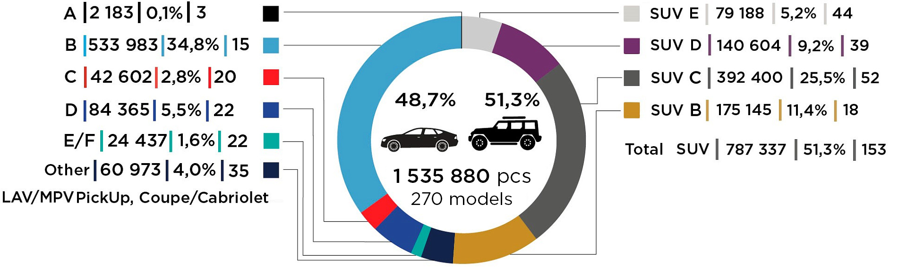
The most popular car classes in Russia
In 2021, the Russian passenger car market was represented by 270 models. And more than half of them (153 models) are SUVs and crossovers. According to AEB statistics, almost half of the demand fell on SUVs: 788 ths. cars were sold during the year.
Fig. 9. Market structure by class 2021
Source: Autostat
+7 (495) 740-16-01
contact@delprof.ru

Slide 14
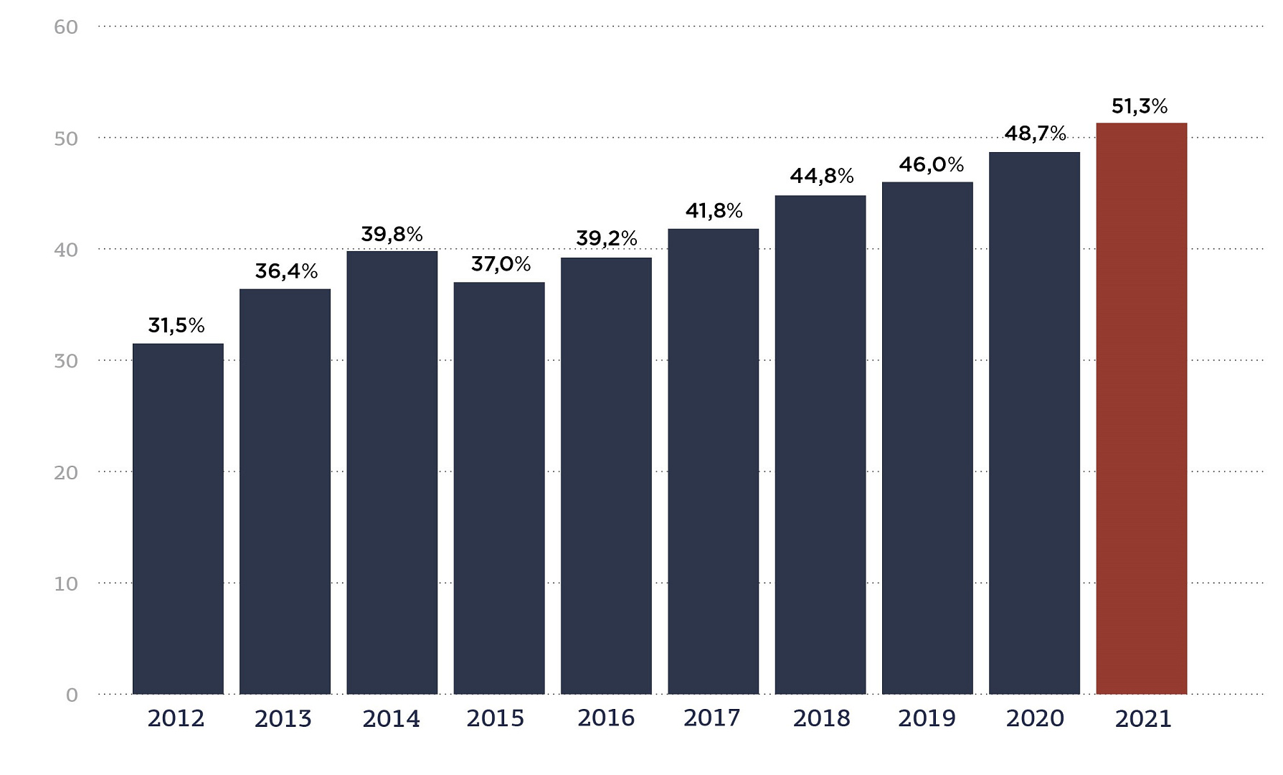
Fig. 10. SUV share growth dynamics, %
SUV class cars in the past year occupied 51.3% of the volume in the market: in piece terms, this is 787.3 ths. cars sold. Moreover, for the first time, the SUV segment models could exceed the indicator by 50%. SUV-C was the largest subclass with a market share of 25.5%: the sub-segment is represented by cars such as Toyota RAV4, Volkswagen Tiguan, Kia Sportage, and the total number of models is 52. Such a segment share in the market can be explained by the number of models representing the SUV-C.
It is curious that class B occupies the second place in the number of sales (34.8% of the market), although it is represented by only 15 models. This class of cars is small in size, but at the same time has a comfortable and spacious interior and a roomy trunk. In the Russian market, the segment is represented by LADA Vesta and Granta, Kia Rio, Hyundai Solaris, Volkswagen Polo, Skoda Rapid. Experts explain the high demand for cars of this type by the fact that in a situation of rising prices, B-class cars remain affordable.
Source: Autostat
+7 (495) 740-16-01
contact@delprof.ru

Slide 15

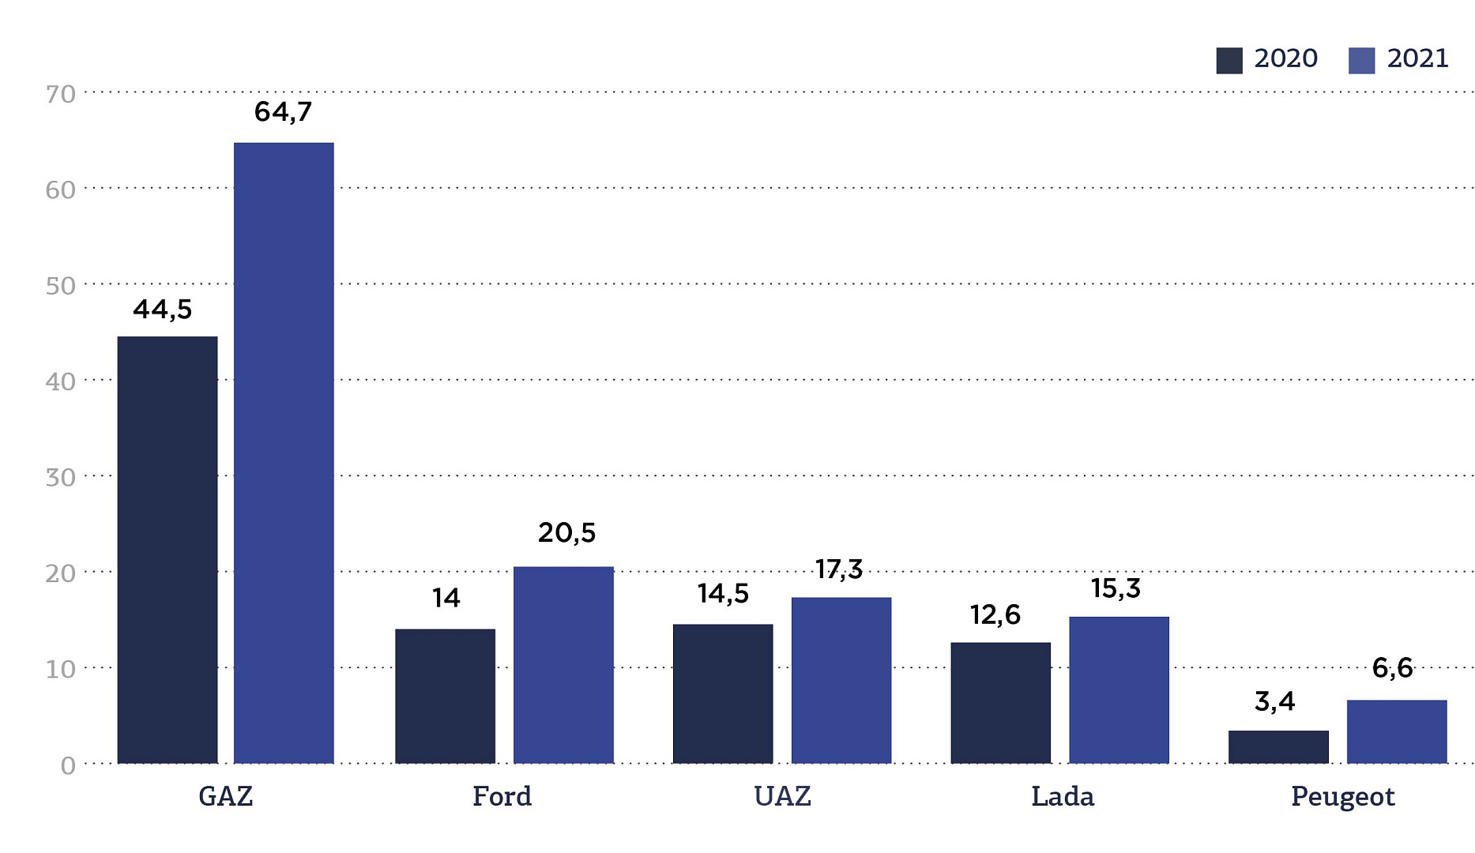
Commercial vehicle segment
Among light commercial vehicles, the production of which in 2021 amounted to 144 ths., the Russian brand GAZ remains the leader in terms of market volume: it occupies 45% of the total volume.
GAZ increased the number of cars produced to 64.7 ths., that is 45% more than in 2020.
The American brand Ford in 2021 produced 20.5 ths. cars, showing an increase of 46%.
The third position in terms of volume was taken by the domestic UAZ with 17.3 ths. cars produced and an increase of 19%. The top 5 LCVs in the Russian market also included Lada, which produced 15.3 ths. cars (21% growth), and the French brand Peugeot, which showed a significant growth in the market of 93%, but the number of cars was almost 2.5 times less than that of Lada - 6.6 ths.
Fig. 11. TOP 5 commercial vehicle brands in Russia 2021
Source: Autostat
+7 (495) 740-16-01
contact@delprof.ru

Slide 16

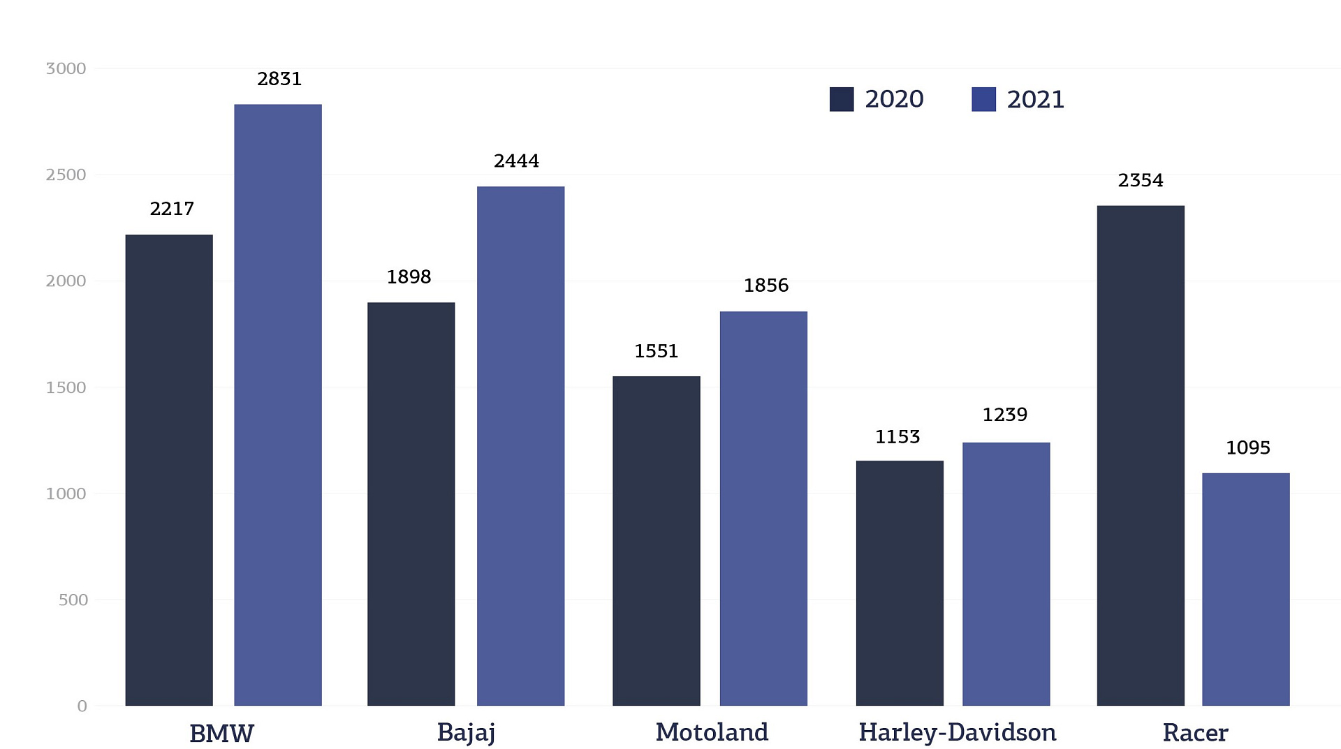
Motorcycle segment
The volume of the domestic market of new motorcycles in 2021 increased by 12.6% (to 18.4 ths.). Five leading brands occupied half of the motorcycle market (51.4%): BMW (2831 motorcycles), Indian Bajaj (2444), Motoland (1856), Harley-Davidson (1239), Racer (1095). All brands, except Racer, showed an increase in volume. Racer lost 53.5%.
Fig. 12. TOP 5 brands of motor vehicles in 2021
Motorcycles are in the greatest demand in Moscow, the Moscow region and St. Petersburg. They account for 20.9%, 11.3% and 7.5% of the market, respectively. Among the non-capital regions, Krasnodar Territory (875 units) and Sverdlovsk Region (867 units) are the leaders in sales. Moreover, it was the Krasnodar Territory that showed the greatest growth in 2021 — by 34.8%.
Usually, buying a motorcycle is a seasonal phenomenon, which affects the demand for motorcycles in different quarters. So, in 2021, only in the second quarter there was a positive trend (58.6%). But according to experts, another factor also influenced the sale in 2021 — low starting figures, since in the spring of 2020 motorcycle dealerships were temporarily closed due to the coronavirus.
Source: AEB
+7 (495) 740-16-01
contact@delprof.ru

Slide 17
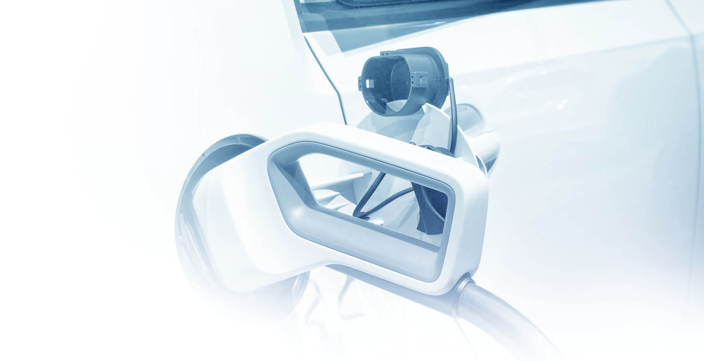
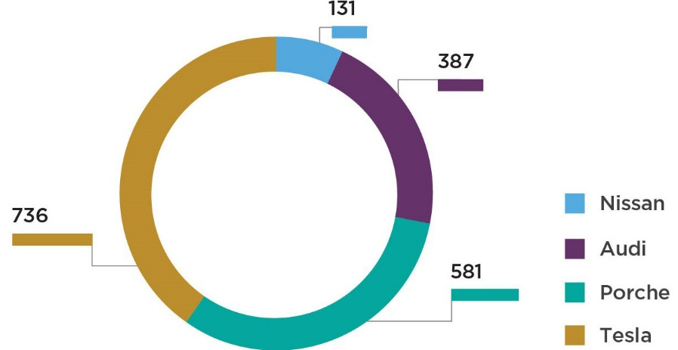
Electric car segment
Over the past year, development has also occurred in the segment of electric cars. According to Autostat, 2,254 new electric vehicles were sold in Russia in 2021. Sales have been gradually growing since 2017, and last year there was a leap. Sales have tripled compared to 2020. We can talk about a new record for the Russian market, because before that the number of chargeable cars sold has never exceeded thousands. At the same time, according to AEB statistics, 1001 electric cars were purchased from official dealers.
Fig. 13. The most popular electric cars in Russia in 2021
About a third of the market is occupied by the Tesla brand (as already mentioned, this brand for the first time in 2021 hit the top 10 in the world market). During the year, Russians purchased 736 such American cars – 3.3 times more than a year earlier. Among them, there are 432 Tesla Model 3 models and 218 Tesla Model Y models.
The second most popular electric car is the Porsche Taycan (581 cars). This model has become the best-selling among new electric cars: it appeared in the Russian market in the autumn of 2020.
The German brand Audi was able to sell 387 cars (Audi e-tron) in the Russian market (increasing sales by 2.9 times).
Another brand that managed to pass the mark of one hundred sold electric cars is Nissan (131 sold Nissan Leaf cars). At the same time, its sales fell by 9%.
Source: Autostat
+7 (495) 740-16-01
contact@delprof.ru

Slide 18
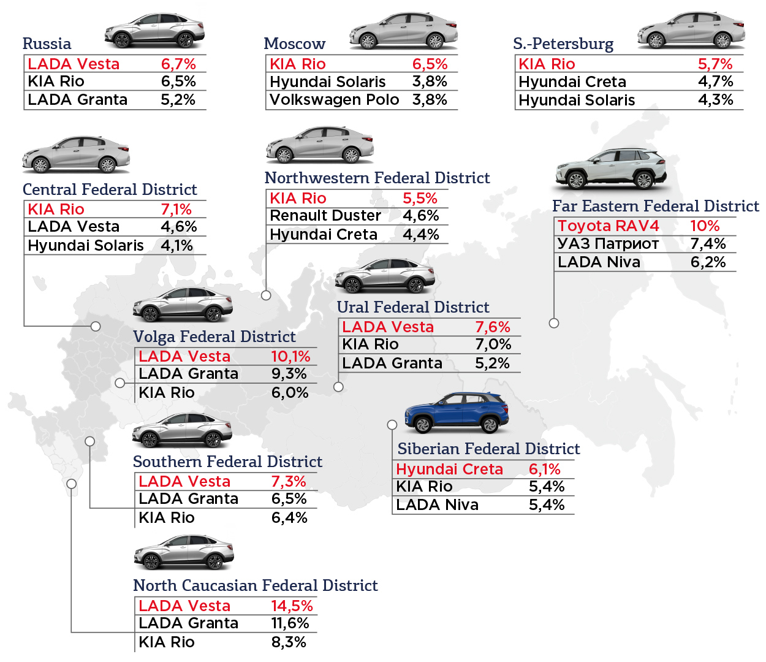
The Russian car market at the beginning of 2022
Fig. 14. TOP-3 brands by sales in federal districts, January-February 2022
In the first two months of 2022, according to a study by Autostat and data from Electronic Passport, Lada Vesta became the best-selling car in four districts at the same time (Volga, Ural, Southern and North Caucasus), which had the largest sales volumes in 2021. The model occupies the largest market share in the North Caucasus (14.5%).
In the central Federal District Kia Rio, which took 7.1% of the market, moved Lada Vesta to the second place in popularity. Also, the Korean foreign car is leading in the North-Western District (5.5%). The model shows high sales both in Moscow (6.5%) and in St. Petersburg (5.7%). It is worth noting that neither Lada Vesta nor Lada Granta got into the top 3 of these cities.
Also, only in two federal districts, crossovers topped the sales rating: in Siberia this is Hyundai Creta (6.1%), and in the Far East – Toyota RAV4 (10.4%).
The main bestsellers in Russia were four models: LADA Vesta, Kia Rio, Hyundai Creta and Toyota RAV4.
At the beginning of 2022, there was a positive trend in terms of the number of car sales centers.
Source: Autostat
+7 (495) 740-16-01
contact@delprof.ru

Slide 19

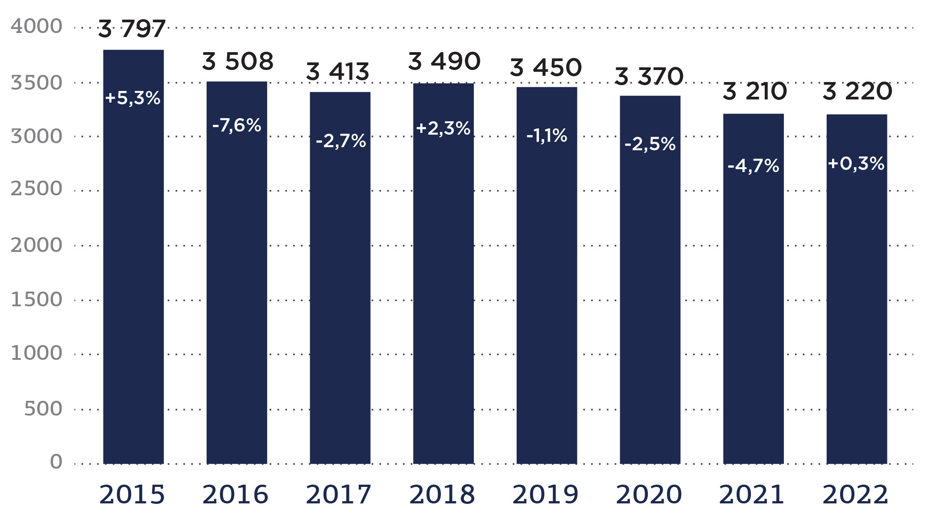
In January 2022, for the first time in the last 4 years, the number of car dealers in Russia stopped declining. For the first 15 days of January, the growth was 0.3%. At that time there were 3,220 official dealerships in Russia.
If we consider the dynamics of changes in the number of dealerships since 2015, we can see a decrease of 15% (data is compared at the beginning of each year) And every year, except 2015 and 2018, there was a decline. So, from 2019 to 2021, the reduction from year to year became larger: -1.1%, -2.3%, -4.7%, respectively.
The positive dynamics that emerged at the beginning of 2022 can be attributed to the creation of a dealer network of the Chinese brand EXEED in Russia.
In total, as of January 2022, there were 732 car dealers of Chinese brands in Russia. That is, Chinese chains occupied 22.5% of the total number of dealers. Most of them are located in the Central and Volga districts – 194 and 169 points of sale, respectively. The smallest share of Chinese car centers is in the North Caucasus District and the Far East (10 and 9). In other districts, the presence of Chinese brands ranges between 80 and 90 dealerships.
Fig. 15. Dynamics of the number of car dealers in Russia
Source: Autostat
+7 (495) 740-16-01
contact@delprof.ru

Slide 20
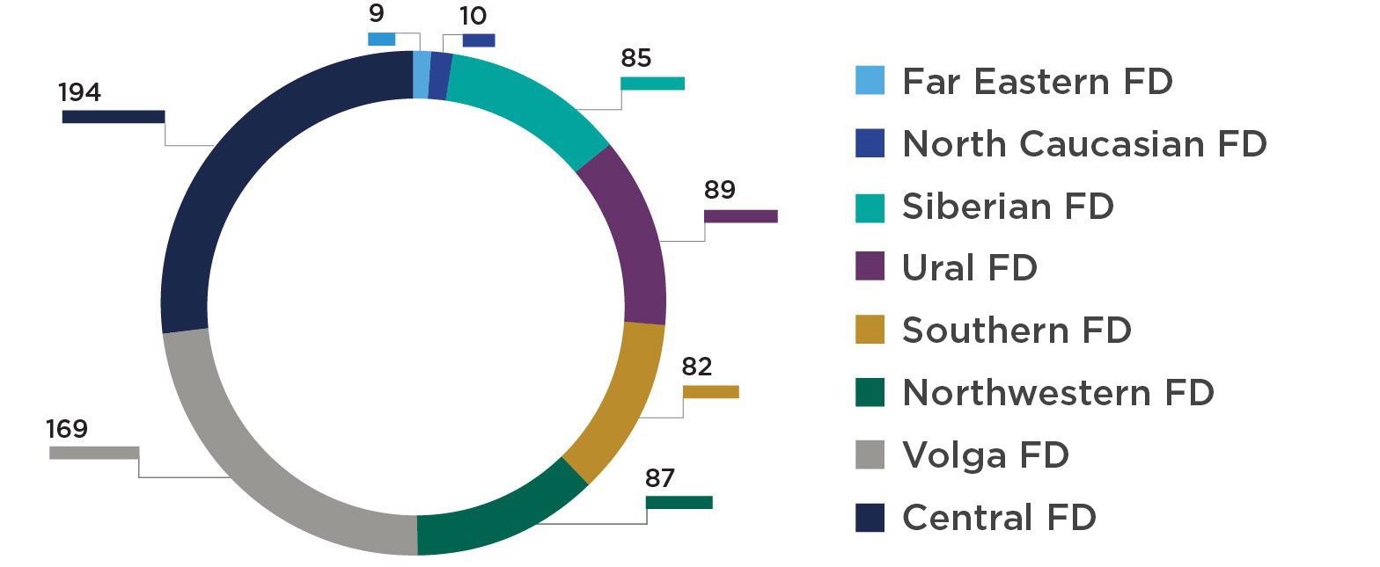
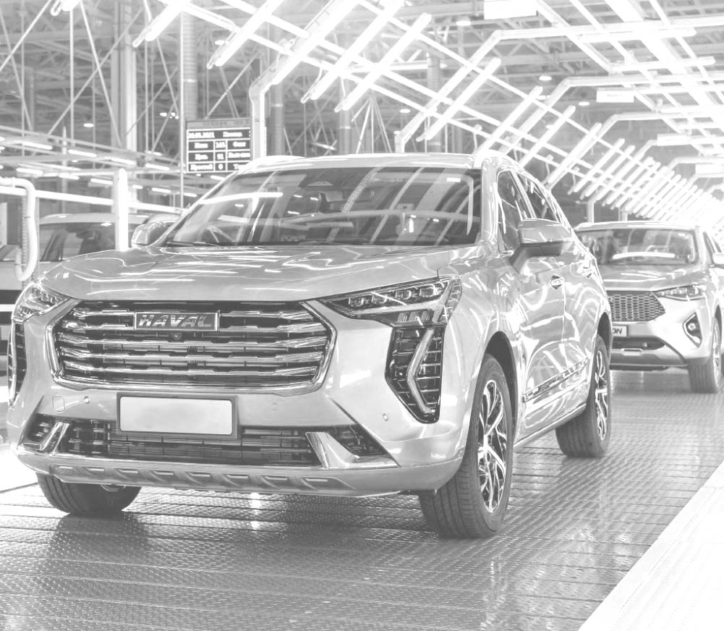
Fig. 16. Presence of Chinese car dealers by districts for January 2022
Source: Autostat
The aggravated geopolitical situation may also contribute to an increase in the share of Chinese cars in the Russian market, which has been growing in recent years. Accordingly, the number of dealerships of Chinese brands may increase. Chinese automotive companies can benefit the most from the situation when sanctions are imposed on Russia and, consequently, European, Japanese and American brands are leaving the Russian market. Moreover, according to experts, it is worth waiting not only for an increase in the manufactured cars of brands that are already present in our market, but also for the appearance of new brands.
+7 (495) 740-16-01
contact@delprof.ru

Slide 21
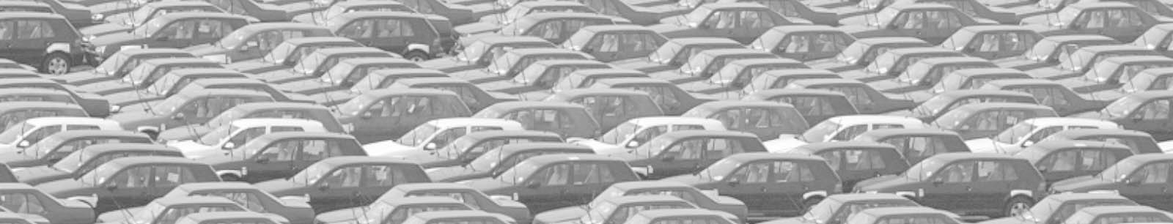
The situation after 24 February 2022:
how sanctions affected the car market
According to the forecasts of the analytical association S&P Global Mobility, in 2022 and 2023, a reduction in global production of passenger cars is expected due to economic problems associated with the deterioration of the geopolitical situation. The number of cars may decrease by 2.6-4 mln.
In an optimistic scenario (a reduction of 2.6 mln.) Europe will lose 1.7 mln. cars, one mln. of which the market will lose due to reduced demand and limited exports in the markets of Russia and Ukraine. Experts attribute the remaining losses of 700 ths. to the shortage of important components. In March of this year, BMW and Volkswagen have already reduced production volumes, as Ukrainian factories stopped supplying wiring harnesses.
In a pessimistic scenario, production will decrease by 4 mln. cars in two years, and by 25 mln. over the next eight years (from 2022 to 2030).
Because of the sanctions, supply chains are being torn, which leads to a reduction or shutdown of production of many brands. In addition, we should expect an increase in prices for energy and raw materials. For example, there may be a violation of logistics for the supply of palladium, 40% of which is exported from Russia. The underproduction of cars will affect the deferred demand: although the unsatisfied purchasing power, which at the beginning of 2022 was 12% (a shortage of 10 mln. cars), was reduced by a third by mid-March.

Slide 22
Automakers which leave the Russian market
It should be noted that so far none of the players in the mass segment has announced their final departure, but many have suspended or temporarily winded down their operations.
Audi suspended operations in Russia on 25 February: deliveries stopped, those cars that had already passed customs at that time managed to enter the Russian market.
BMW announced its withdrawal from the Russian market on 1 March: deliveries were stopped, as well as the work of the Avtotor plant was stopped in Kaliningrad. Moreover, due to the violation of logistics, the brand also suspended the work of its foreign enterprises.
Rolls-Royce, although Russia was the largest market for the brand in Europe.
Infiniti, Lamborghini, Porsche - dealerships continue to sell cars that were paid for by Russia earlier.
Jaguar Land Rover, Ferrari, Mercedes-Benz, Ford, Nissan, Honda, Toyota - due to logistics violations.
Volkswagen AG - discontinued production of Volkswagen and Skoda at factories in St. Petersburg and Nizhny Novgorod.
Changan is one of the few Chinese brands that has left Russia. The company stopped production at the Unison plant in Belarus, where crossovers were also assembled for deliveries in Russia.
+7 (495) 740-16-01
contact@delprof.ru

Slide 23
However, many car manufacturers, mainly Chinese and Korean brands, continue to operate in Russia:
But Korean automakers Hyundai and Kia do not plan to leave the Russian market: cars of these brands are in high demand in Russia. And in February of this year, Kia sold 15,001 cars, although this is 9% less compared to February 2021.
Mazda also remains in the Russian market for the time being: the assembly of the Mazda6, CX-5 and CX-9 models continues in Vladivostok.
Stellantis Concern continues the work of the plant in Kaluga: Peugeot, Citroen and Opel commercial vehicles and Citroen C4 Sedan and Peugeot 408 passenger cars are assembled there.
Other Chinese brands (Chery and EXEED), although they temporarily stopped buying cars for Russia in February due to the instability of the ruble, still resumed production and remained in the Russian market. In Russia, Chery sells Tiggo 8 Pro, Tiggo 8, Tiggo 7 Pro and Tiggo 4 crossovers. According to AEB, 2907 cars of this brand were sold in February (+45%)
Another Chinese brand Dongfeng (not the most popular in the Russian car market) continues to sell: it even increased the cost of its only model in Russia (DFM 580 crossover) by RUB 200 ths.
Also, the Chinese brand GAC Motor did not stop deliveries: the company plans to introduce a second-generation GS8 crossover to the Russian car market in 2023, in addition to the GS5 and GS8 SUVs already present in Russia and the GN8 minivan.
Both Geely and Haval are not going to stop cooperation with Russia. In February, the Geely brand sold 82% more cars in the Russian market than in the same period of 2021 (2,188 units).
+7 (495) 740-16-01
contact@delprof.ru

Slide 24
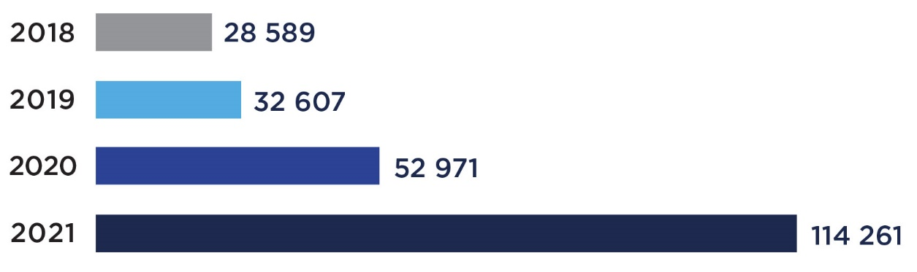
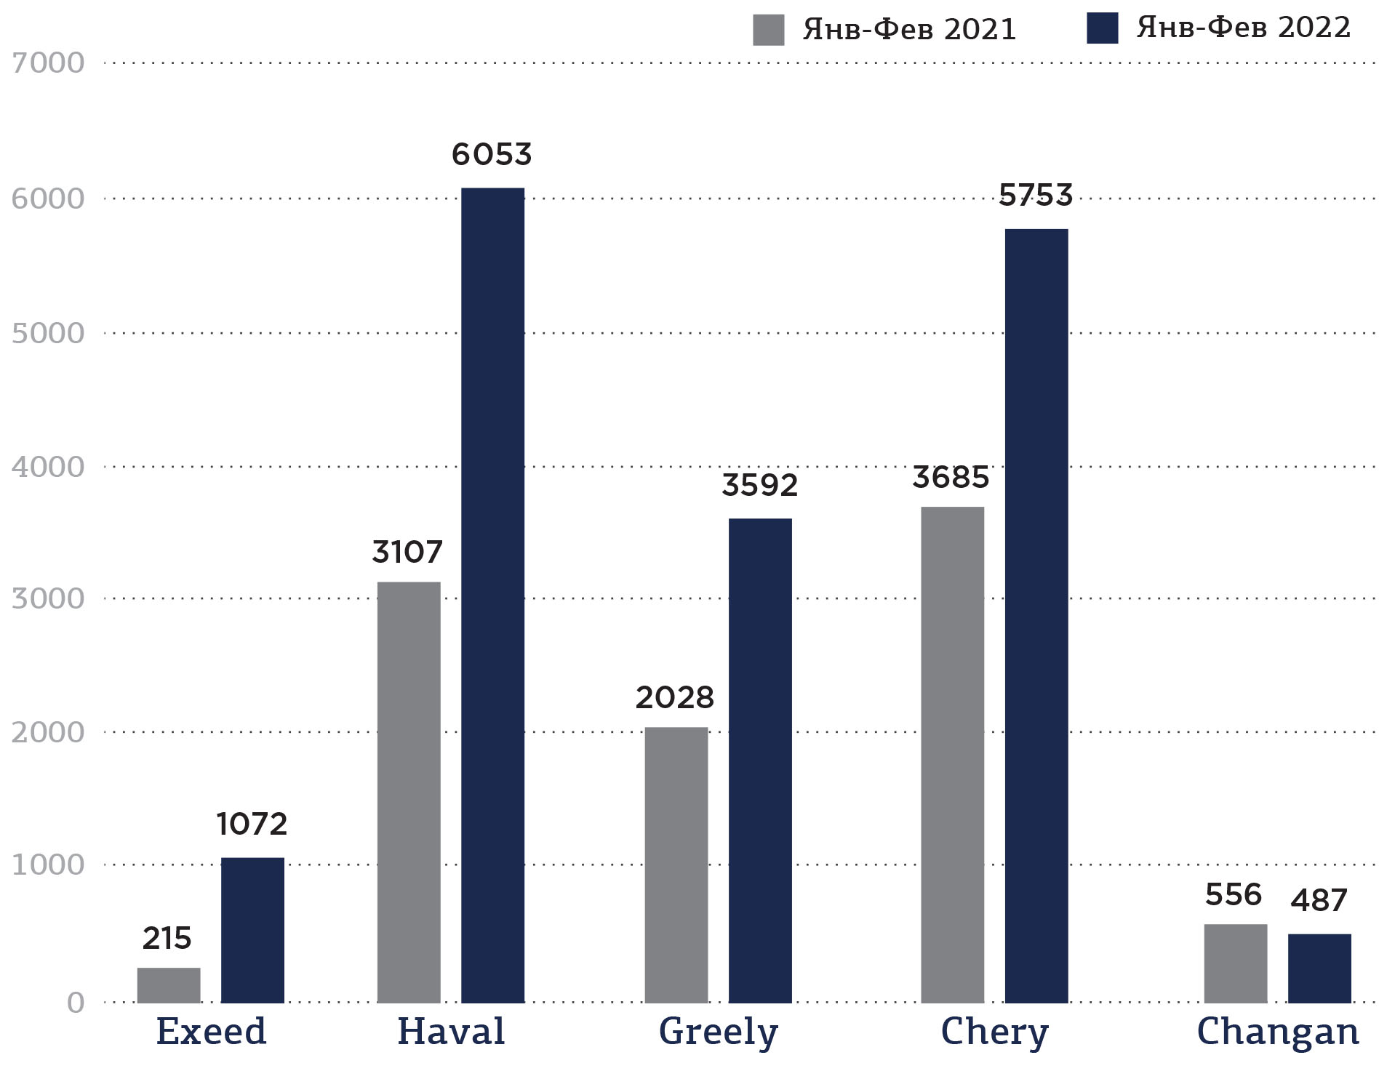
Fig. 17. Sales of Chinese cars in 2018-2021
Fig. 18. Sales of popular Chinese brands in January-February of the last two years
Jan-Feb 2021
Jan-Feb 2022
Source: Autostat
Sales of Chinese cars have been growing over the past few years.
In addition, sales of all Chinese brands that are present in the Russian car market increased in the first two months of this year. Changan's sales alone fell by 12%. In total, in the first two months of the year, sales of Chinese cars increased by 72% (in 2022 – 17,545, in 2021 — 10,203).
Most likely, in 2022 China will take an even larger share of the Russian car market.
Source: Autostat
+7 (495) 740-16-01
contact@delprof.ru

Slide 25
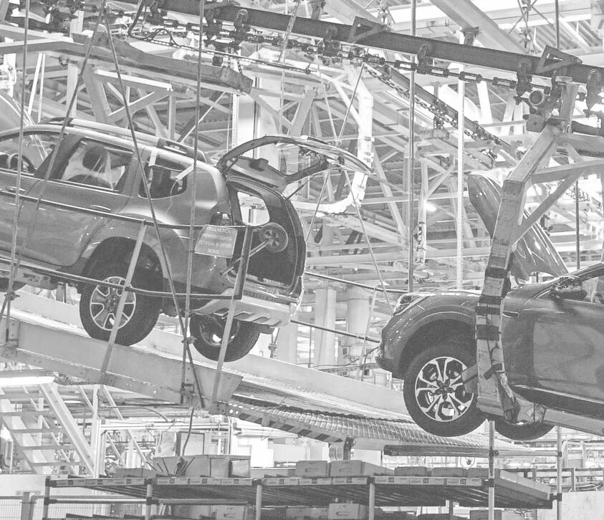
Prospects for the development
of the Russian automotive industry
Despite the fact that Chinese brands will occupy a certain segment of the market, some experts suggest that the Russian car industry and the car market may follow the Iranian path.
Massive sanctions were imposed on Iran in 2012: the volume of the Iranian car market in 2011 (1.59 mln. cars) is comparable to the volume of the Russian market on the eve of sanctions (1.54 mln. in 2021); both states are economically heavily dependent on oil, and both Russia and Iran are striving to create a large-scale own car industry. If Russia does repeat the path of Iran, then next year (2023) it is worth waiting for the market to decrease by about half compared to the indicators of 2021.
Obviously, due to the withdrawal of most foreign brands (primarily Western ones) from the Russian market, sales in March should have fallen. According to Autostat, in March 2022, the Russian car market lost ground by 43% compared to March last year. And according to the AEB, the sale of cars decreased by 63%. The difference of 20% is due to differences in the data that are analyzed: Autostat compares final sales, and AEB - data on the shipment of cars.
According to the AEB, 55 ths. cars (passenger cars and light commercial vehicles) were bought in Russia in March – a year ago in March 149 ths. were sold.
+7 (495) 740-16-01
contact@delprof.ru

Slide 26
Table. 1. Sales dynamics of brands in the Russian market by volume in March
Car brand | March
 | 2022 | 2021 | %
AVTOVAZ (LADA) | 12 289 | 33 779 | -64%
Kia | 6 336 | 20 057 | -68%
Hyundai | 4 909 | 15 332 | -68%
Renault | 4 072 | 11 659 | -65%
Toyota | 3 231 | 10 278 | -69%
GAZ (LCV) | 2 886 | 4 521 | -36%
Skoda | 2 803 | 9 737 | -71%
Nissan | 2 699 | 5 705 | -53%
Volswagen | 2 435 | 9 442 | -74%
UAZ | 2 206 | 2 733 | -19%
Mazda | 1 621 | 2 689 | -40%
Haval | 1 573 | 2 833 | -44%
Geely | 1 492 | 1 732 | -14%
Ford (LCV) | 874 | 1 409 | -38%
Mitsubishi | 801 | 2 230 | -79%
Audi | 585 | 1 625 | -64%
Cheryexeed | 505 | 309 | 63%
Chery | 498 | 2 398 | -79%
Peugeot | 323 | 736 | -56%
Changan | 311 | 485 | -36%
Suzuki | 305 | 931 | -67%
Lexus | 229 | 2 491 | -91%
Volvo | 224 | 798 | -72%
Subaru | 206 | 674 | -69%
Porsche | 192 | 703 | -73%
Land Rover | 155 | 633 | -76%
Car brand | March
 | 2022 | 2021 | %
Citroen | 155 | 371 | -58%
FAW | 154 | 240 | -36%
Isuzu | 153 | 27 | 467%
Volkswagen (LCV) | 142 | 555 | -74%
Infinity | 110 | 234 | -53%
Genesis | 102 | 245 | -58%
Jeep | 98 | 121 | -19%
Chevrolet | 82 | 43 | 91%
DFM | 80 | 0 | -
Opel | 70 | 124 | -44%
Honda | 42 | 139 | -70%
Cadillac | 37 | 302 | -88%
Great wall | 33 | 0 | -
Hino | 27 | 0 | -
Iveco | 27 | 40 | -33%
GAC | 22 | 68 | -68%
Fiat | 19 | 113 | -83%
Jaguar | 15 | 19 | -21%
Foton | 1 | 11 | -91%
Ford | 0 | 0 | -
Brilliance | 0 | 22 | -
Lifan | 0 | 76 | -
Zotye | 0 | 6 | -
Chrysler | - | 0 | -
Hyundai (LCV) | - | 1 | -
Total | 55 129 | 148 676 | -62,9%
Source: AEB

Slide 27
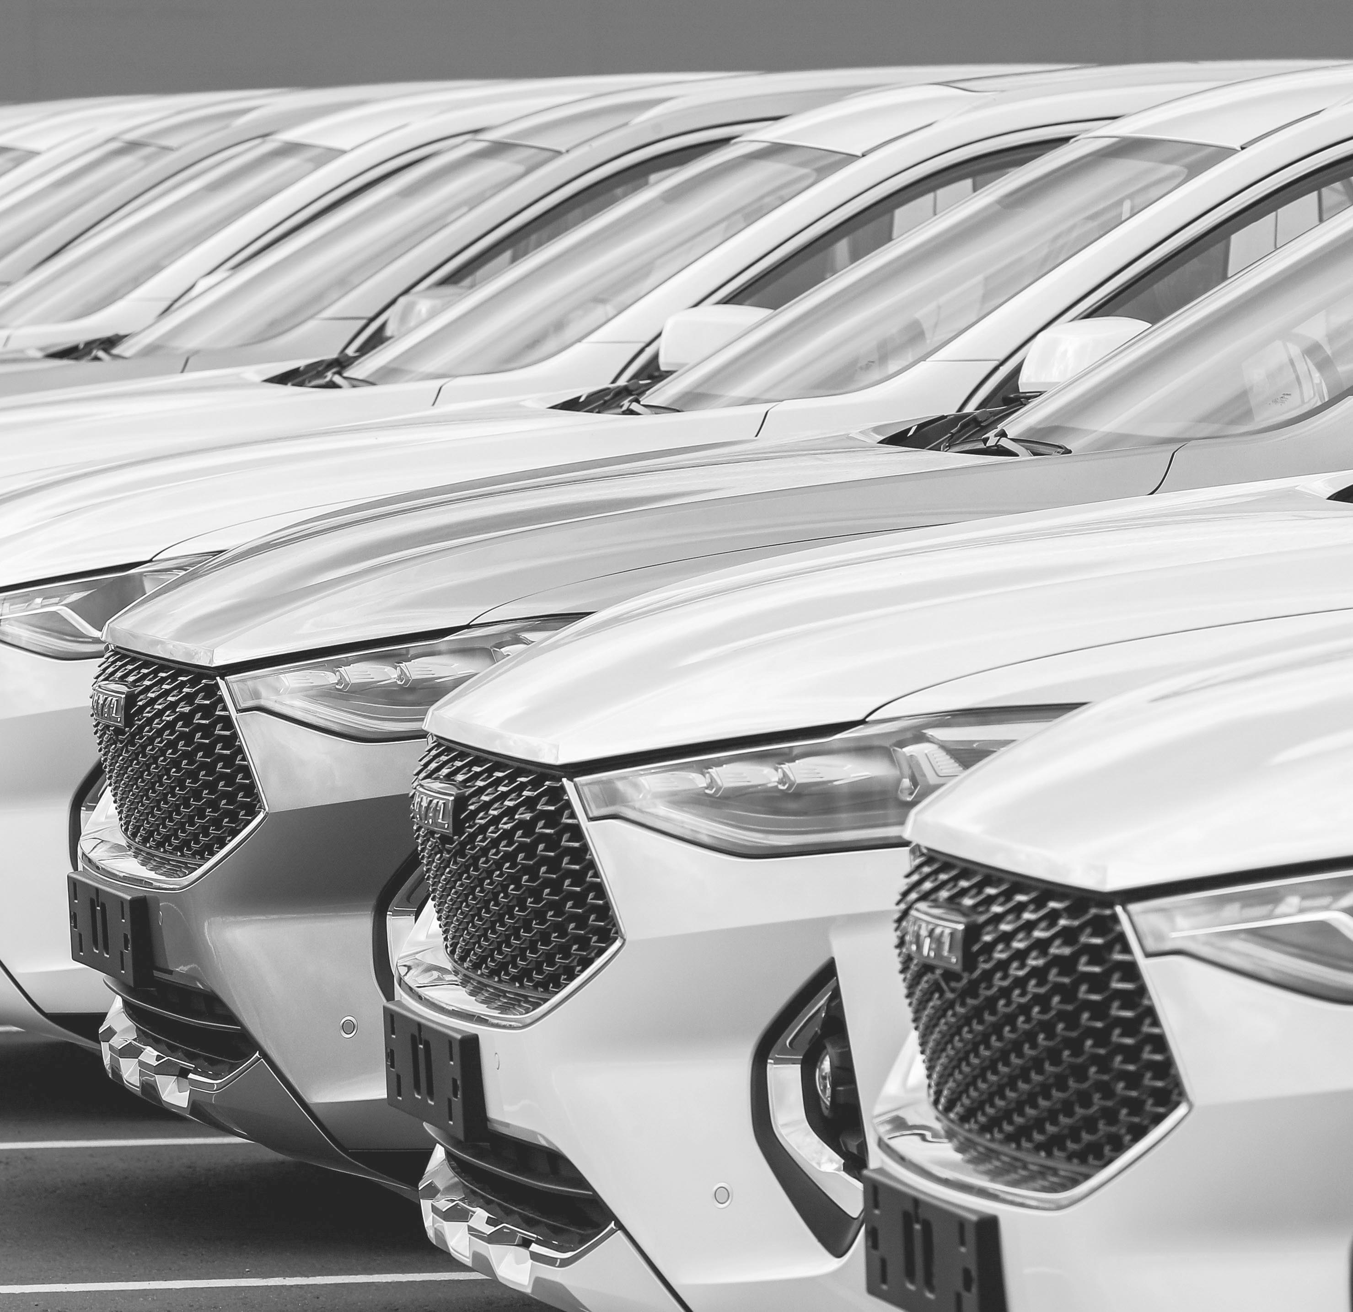
Most of the brands have gone into the red. Domestic UAZ and GAZ have lost ground (by 19% and 36% respectively) in contrast to AVTOVAZ, whose sales have fallen by 64%. The reason for this is the shortage of components (in particular, electronic ones). Therefore, the company even decided to produce Lada Niva and Lada Granta without ABS (anti-lock wheel system), EPS (dynamic stabilization system), without ERA-GLONASS (satellite emergency alert system: it cannot be installed until mid-2022).
There is a reason to believe that the market may lose 50-70% this year.
For foreign car and motor vehicles producers from countries that have not imposed restrictions on trade with Russia, it may now be reasonable to analyze the potential of the Russian market and its capacity. The shock of the population and business is coming to an end, entrepreneurs and citizens are adapting to the sanctions, which means that demand, including demand for cars, is recovering.
In a situation where most of the brands that have tightly occupied the market over the past decades have had to leave for certain reasons, attractive niches are being released. And if they are occupied by a producer he will be able significantly increase its share of the Russian market in a few years.
+7 (495) 740-16-01
contact@delprof.ru

Slide 28
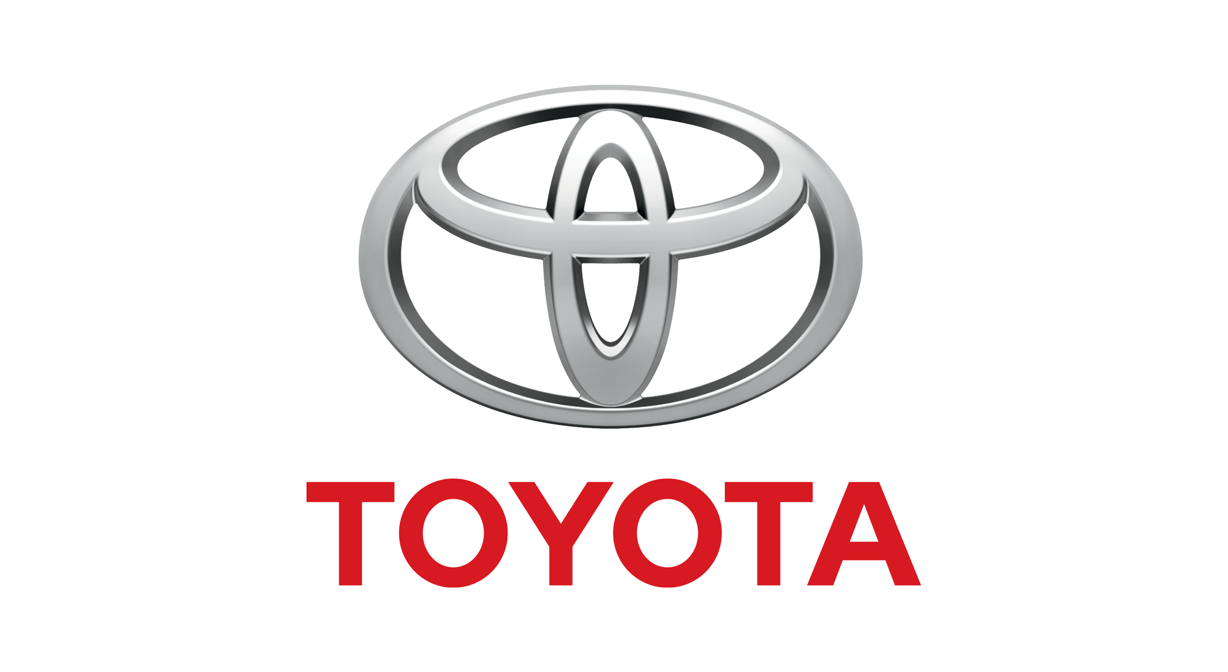

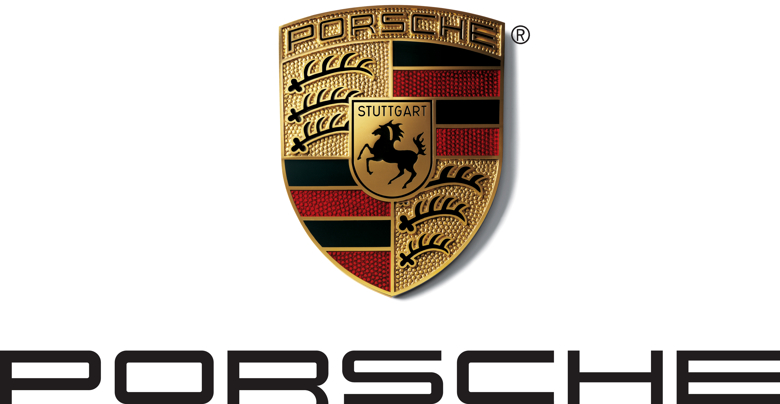
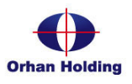
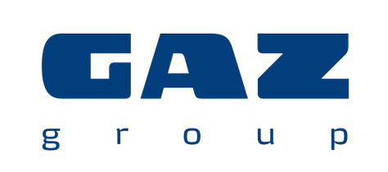

About us
Our experts have been providing professional services in a wide range of consulting areas, including business and financial management, investment attraction, crisis solutions, taxation and law for more than 26 years – since 1995.
DELOVOY PROFIL Group is more than 200 highly qualified specialists and 9 consulting directions ready to promptly respond to the new business reality challenges and support your goals from the preparation stage to monitoring the effectiveness of the implemented solutions.
More details on the official web-site: https://delprof.ru/en/
Ratings
DELOVOY PROFIL Group is one of the largest Russian consulting organizations that is annually ranked among the
TOP 30 market leaders.
Among our clients
We have successfully completed projects for major automobile and spare parts producers.

Slide 29
Support by
DELOVOY PROFIL Group includes
Marketing research and business diagnostics
new niches and markets analysis;
region marketing strategy development;
study of regional consumers' preferences, analytical research for the development of positioning, analysis of the target audience;
setting up a system of procurement and interaction with new suppliers and contractors;
business processes optimization;
benchmark analysis for optimal solutions, automation of business processes, etc.
Tax consulting
assistance in system of taxation and tax planning choice, formation of tax policy;
consulting on tax benefits;
tax expertise of transactions, tax risks level assessment, recommendations on tax risks reduce;
consulting on transfer pricing issues, preparation of notifications on controlled transactions, etc.
Legal support – registration and interaction with state authorities
advising on the establishment and registration of legal entities, development of an effective legal structure;
support in registration procedures;
legal support of work with new contractors – development of draft agreements, interests representation in negotiations, etc.
Budgeting and finance optimization
efficient internal control system establishment;
organization’s accounting policy establishment;
development of regulations for budgeting and further automation;
management accounting establishment, etc.
Finance and investment attraction
development of business plans, conducting the technological and price audit;
investment projects valuation;
consulting on concessional lending in accordance with new measures of state business support, etc.
We are ready to support your efficient business development at the Russian automotive market!

Slide 30



Contact us
If you have any additional questions or need the expert’s consultation on prospects for development at the Russian market, please, contact us by email or telephone below.
+7 (495) 740-16-01
contact@delprof.ru
https://delprof.ru/en/
ALEXANDRA SHNIPOVA
Deputy head
of Management consulting
The opinions presented herein are based on the situation as of the date of publication and may not be current as of the date of reading. This document is for informational purposes only and should not be relied upon to make professional judgements. DELOVOY PROFIL Group cannot be held responsible for any actions taken on the basis of the information contained herein. If you have any specific questions, please contact a specialist in the relevant field.
© 2022 JSC AC «DELOVOY PROFIL». All rights reserved.

